Slide 1
Royal Mail Group

Slide 2
What is BDD?
In software engineering, behavior-driven development (BDD) is a software development process that emerged from test-driven development (TDD).
BDD is a development process where tests for code are written before the writing of implementation code.
BDD means examples (or scenarios) are written *before* the implementation of the software and happens iteratively, in collaboration with non-technical stakeholders.
Automated acceptance tests are a by-product of BDD.

Slide 3

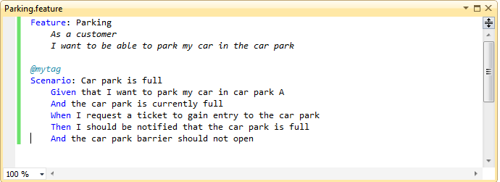

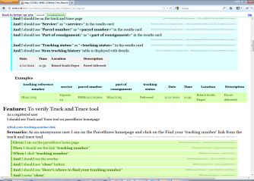
BDD development process
2.The Business Analyst, Tester, Developers elaborates requirements together.
3.The scenarios act as a guide to developer and act as automated tests
they define requirements as structued, english language format "scenarios"
Given - When - Then
1. The business Owner and Business Analyst have a discussion about what it he needs.
5.Automated test provide feedback on progress and help as documentation.
4. Tester uses these scenarios as basis of her tests.

Slide 4
“5 Whys” technique why use BDD
Q1. Why would we use BDD?
A1. To get a better quality product
Q2. Why?
A2. Because we (often) get it wrong
Q3. Why?
A3. Because there are misunderstandings, ambiguities or errors in what has been specified and/or what we eventually get in the form of the product
Q4. Why?
A4. Because the traditional methods for specifying behaviour are not always effective in capturing
Q5. Why?
A5. Because they fail to use concrete examples and a ubiquitous language

Slide 5
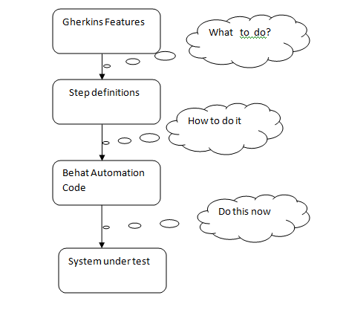
Behat Test Suite Structure

Slide 6
What Gherkin for ?
When we build software for stakeholders or client, it is difficult to figure out exactly what they want us to build.
We’ve all worked on projects where, because of a misunderstanding, code that we’d worked hard on for several days or more had to be thrown away.
Better communication between developers and stakeholders is essential to help avoid this kind of wasted time.

Slide 7
Building one Vocabulary :
eliminating some of ambiguity and miscommunication
for Business
for analyst
for Testers
for Developers

Slide 8
A Gherkin source file looks like
Feature: {custom title}
In order to {benefit/value of the feature}
As a {user/role who will benefit from this feature}
I need to {short feature description}
Scenario: Some determinable business situation
Given some precondition
And some other precondition
When some action by the actor
And some other action And yet another action
Then some testable outcome is achieved
And something else we can check happens too

Slide 9
What is behat?
Behat is an open source behavior-driven development framework for PHP 5.3 and 5.4.
A testing framework written in PHP
Accepts tests written in business domain language
Executes those tests on your PHP based application
Designed to test behavior of your application
Behat does one simple thing:
It maps Each Step to PHP callback
Behat “executes” your scenarios, reading each step and calling the function associated with it
Each line in scenario is called a “Step”

Slide 10
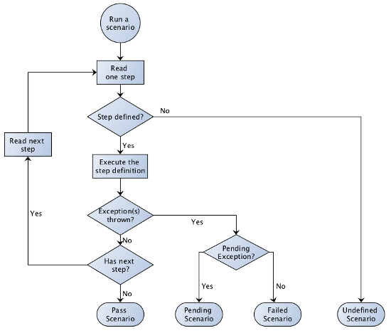
How Cucumber executes scenario

Slide 11
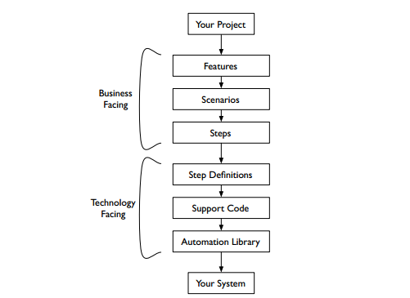
Cucumber testing stack

Slide 12
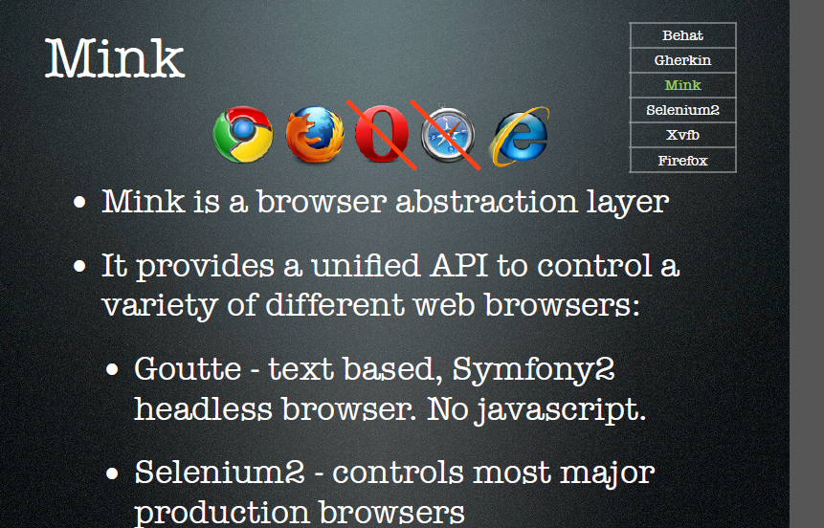
Mink
Notes:
So, in order to test our web application, we should transform user actions into steps and expected outcomes. So through mink, behat is interacting with web.

Slide 13
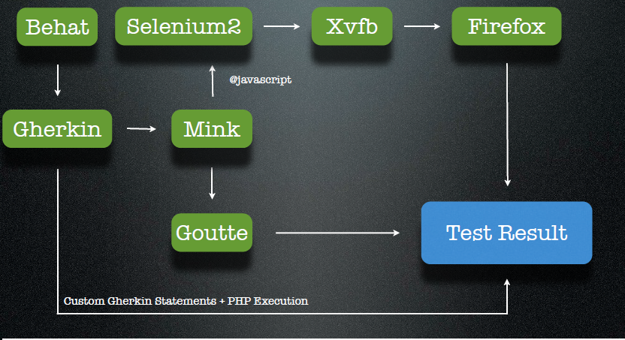
Behat interaction with Firefox

Slide 14
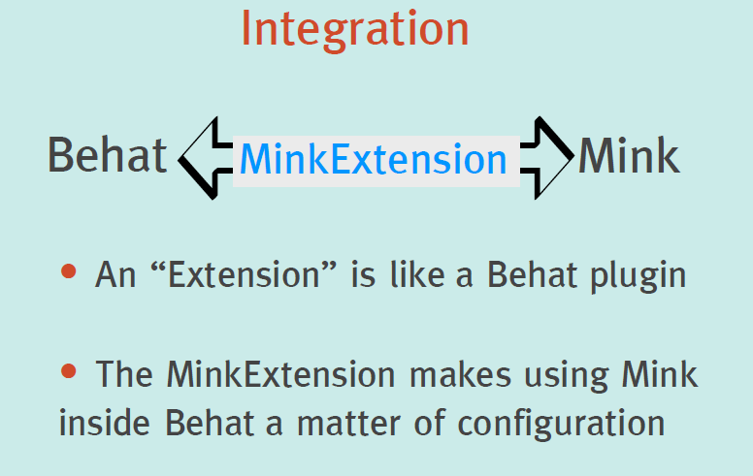
Need of MinkExtension

Slide 15
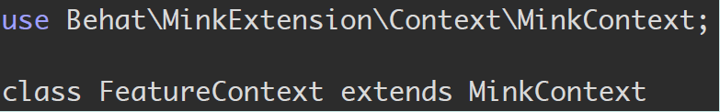
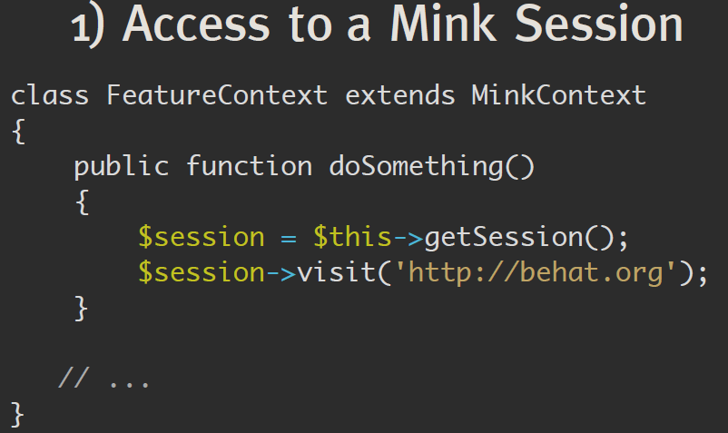
Extending MinkContext & Access

Slide 16
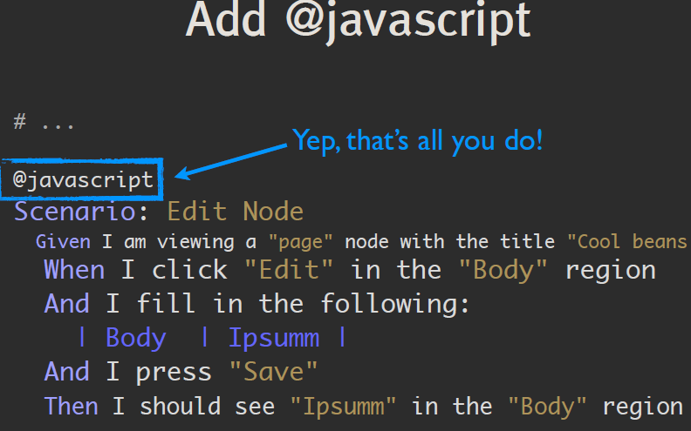
If you want to run behat tests into selenium

Slide 17
Smoke testing CI way
Why Jenkins
Jenkins is one open source tool to perform continuous integration. The basic functionality of Jenkins is to monitor a version control system and to start and monitor a build system (for example, Apache Ant or Maven) if changes occur. Jenkins monitors the whole build process and provides reports and notifications to alert maintainers on success or errors.
Selenium Grid set up
Selenium grid set up is done in Linux machine wherein Jenkins is also installed and it will be continuously running and listening to nodes , which is again set up as a service.
Xfvb server is used to capture screen in case a failure occurs on Firefox browser.
What a Jenkins job accomplishes:
For every application to be tested in Jenkins a job is set up.
Inside a job ,a Jenkins user with appropriate access rights can download all behat tests from Central Git repository
into job’s workspace.
This central repository is maintained with latest test changes/ added with new behat tests from testers on daily basis.
A shell command execution step is included inside a job with proper command line options are set up for behat tests executions.
Once behat build job is started , each feature behat test will invoke Firefox instance and start replicating test steps as scripted.
At the end of execution with e-mail extension plug in , a list of participants will be informed about status of smoke tests.
These behat smoke tests job are triggered only after upstream development build job are over and completed.

Slide 18





1
JIRA Ticket is created and tester develops behat test.
Behat test is written.
Behat test verified against SIT and UAT environments.
Completed test is committed to new Git feature branch.
Pull request (review ticket )is created in Git tool for review.
After review completion JIRA ticket is updated.
and behat test is merged in Git central repository.
7. Jenkins build checks out latest behat tests from Git repo.
Currently daily 3 builds execute smoke tests in test environment.
9. Build produces behat test in HTML format.
10. Also HTML report/s mailed to everyone in team with Failure screens, (if any) daily from Jenkins.
Continuous Integration Server Jenkins
RML Smoke build
2
8
Shell
Script
3
9
6
5
Git feature
branch
Git central repository
7
4
10

Slide 19
Tools used
Jenkins - Continuous Build System
Git- CVS
Selenium standalone server in Linux machine as start up service in Hub mode
Behat- Test Framework
Firefox
Slack –notification
Key benefits of Smoke tests CI way
communication enhancement and customer satisfaction
Early feedback from SIT and UAT builds to developers i.e. after every new built of website, instant feedback can be provide
via smoke tests report.
Immediate bug detection
No integration step in the lifecycle

Slide 20
Thank You

